Slide 1
Chart Proof of Concept
Keita Nonaka
Notes:
Standardization uPlot and and compare with new chart library

Slide 2

Background: Bugs
Chart specific bugs are reported frequently
Remaining bugs still exist
Notes:
Web Team frequently got bug report about chart itself, and some bugs are not fully resolved yet
For example, text overlapping
Legend layout disorder
Bug fixes sometimes create new bugs unexpectedly due to the code complexity
Adding new features on top of the current implantation is feasible but willing to do it? Since there is no documentation

Slide 3
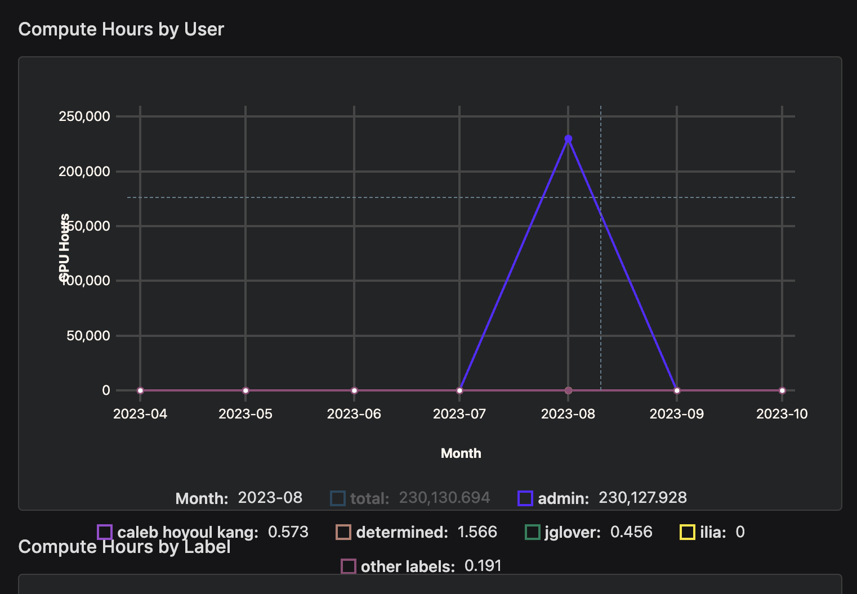
Background: Bugs
Notes:
Web Team frequently got bug report about chart itself, and some bugs are not fully resolved yet
For example, text overlapping
Legend layout disorder
Tooltip does not go away
Tooltip is truncated
Not render charts properly in trial page
Bug fixes sometimes create new bugs unexpectedly due to the code complexity
Adding new features on top of the current implantation is feasible but willing to do it? Since there is no documentation

Slide 4

Background: Flexibility
Unexpected bugs
Hard adjustment
No docs
Notes:
uPlot is flexible but no one owns the chart code so it is hard to add many features without bugs
Bug fixes sometimes create new bugs unexpectedly due to the code complexity
Adding new features on top of the current implantation is feasible but willing to do it? Since there is no documentation

Slide 5
So…What do we want?
We want a chart library that is
Out of the box with great docs
Customizable without tons of custom code
Performant
Supportive of many types of charts
🤔
Notes:
For the performance reasons, we want to use canvas-based charts.

Slide 6



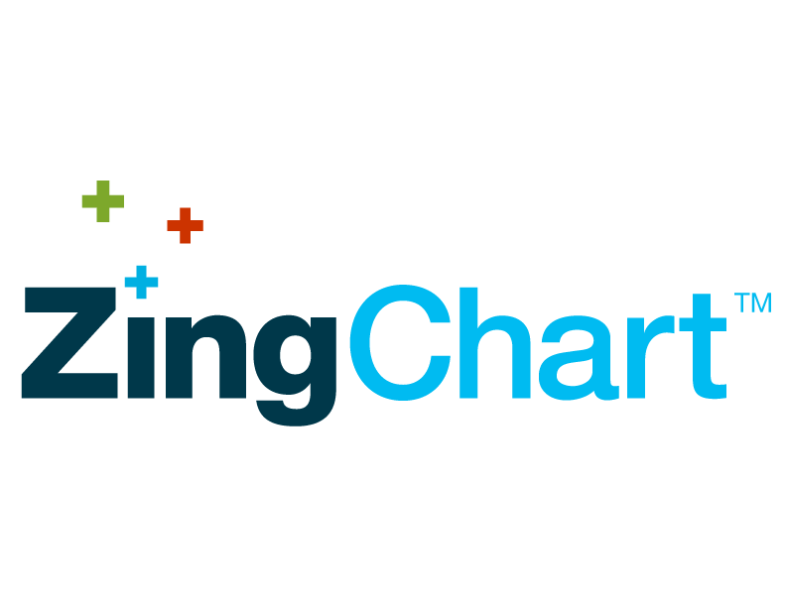



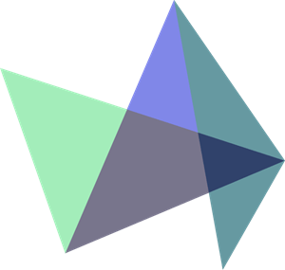
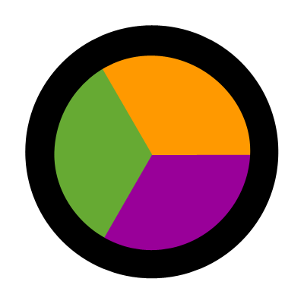
Candidates
8
Canvas Based
Canvas.js
7
2
👍 Many editable examples
❌ Not downloaded much in npm (weekly 3,446 download)
❌ There are docs but not as informative as others
6
uPlot
5
4

Slide 7
Candidates
2
SVG Based
Apex Chart
8
uPlot
👍 Support CSV and Image download by default
👍 Well documented
👍 Many examples
❌ Not as performant as they say
7
4
6
5

Slide 8
Candidates
uPlot
Canvas Based
Chart.js
2
4
👍 Very performant
👍 One of the most popular chart libraries
👍 Lightweight
👍 Many editable examples
❌ Need to add plugins for some missing features
such as zoom. That would increase bundle size
❌ Only support basic charts
8
5
7
6
Notes:
We might need to add plugin for sync charts

Slide 9
Candidates
2
4
Canvas Based
uPlot
uPlot
5
👍 Lightweight
👍 Very performant
❌ Requires plugins for additional features
❌ Does not support many kinds of charts
6
8
7

Slide 10
Candidates
uPlot
2
5
Canvas Based
Flot
4
6
👍 Good for jQuery
❌ Docs are limited
❌ Requires plugins for additional features
7
8

Slide 11
Candidates
4
uPlot
6
High Chart
5
7
2
👍 Many examples
👍 Well documented
👍 Support many types of charts
❌ Unpacked bundle size is huge (116MB)
❌ Not completely free
❌ Need to buy license for more features
8

Slide 12
Candidates
5
4
7
Canvas Based
Lightning Chart
6
uPlot
8
👍 Performant
👍 Support many types of charts
❌ Need to pay for license
❌ Not as popular as other libraries in NPM
(weekly 2,447 download)
2

Slide 13
Candidates
6
5
8
Canvas and SVG Based
Zing Chart
7
4
👍 Support many kinds of charts
👍 Many examples
❌ Not performant
❌ Not as popular as other libraries in NPM
(weekly 3,189 download)
uPlot
2

Slide 14
Candidates
7
6
React Vis
8
5
👍 Many examples
👍 Well documented
❌ No GitHub activity for 4 months
❌ Found some bugs in Demo (zoom)
4
uPlot
2

Slide 15
Candidates
8
7
Canvas and SVG Based
ECharts
6
👍 One of the most popular chart libraries
👍 Very performant
👍 Many editable examples
👍 Many functionalities without adding plugins
👍 Well documented
👍 Support many types of charts
❌ Bundle size could be big
5
2
4
uPlot

Slide 16

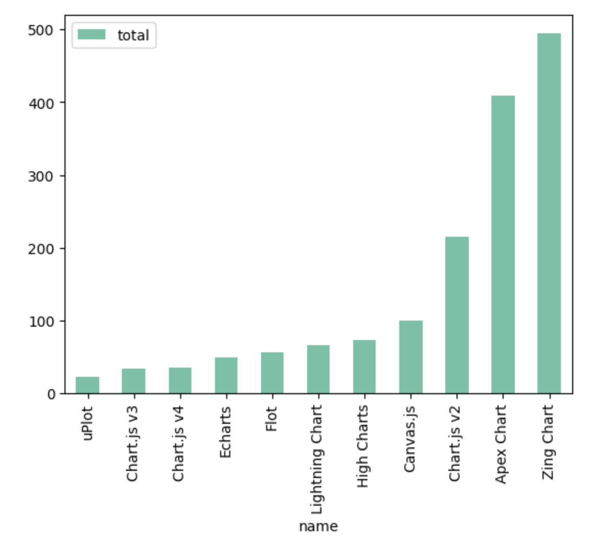
Performance Comparison
with 388,858 data points
ms

Slide 17
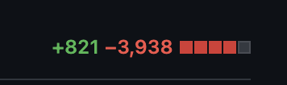
Echarts Pros
2 days for line chart
1 day for scatter plot
EASY PEASY!!
Notes:
https://github.com/determined-ai/determined/pull/8092

Slide 18

Echarts Cons
4.84MB
13.0% increase
4.27MB

Slide 19
DEMO

Slide 20

Feedback from other teams
He loves the new charts. One minor thing is that he is not used to using the new zoom feature since it is new, but he said it is fine and not a big problem.
She has been showing demos in many conferences, but she did not know that line chart is zoomable due to the UI. She said she prefers ECharts because zoom and its range are visible.
Michael: ML System
Isha: Developer Advocate

Slide 21
Any Questions?

